Slide 1
Car Rentals Project Pitch
Group 70 - Team S.K.R.A.M
Workshop time: Thursday, 6:00-8:00PM
Tutor : Kerry Chu
Team member
Kaushal Kishorbhai Limbasiya
Riley Duggan
Shaleen Dutt
Alana Fitzgerald
Ruoxuan Zhang (Mike)

Slide 2
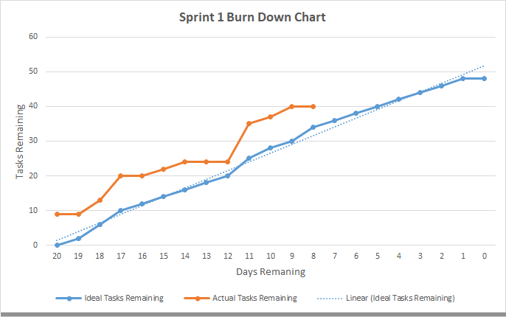
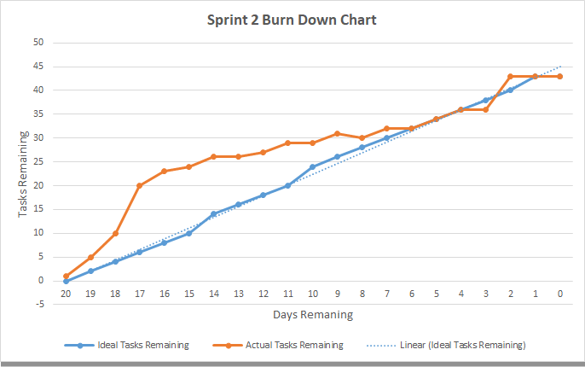
Sprint burndown charts

Slide 3
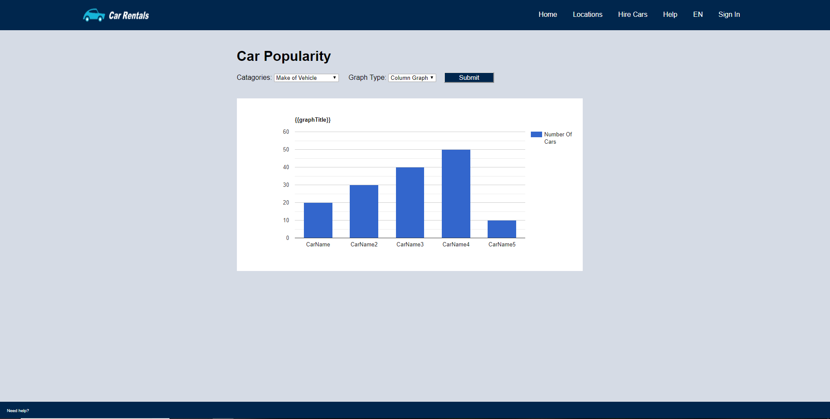
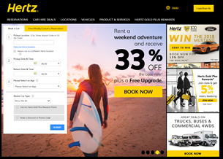
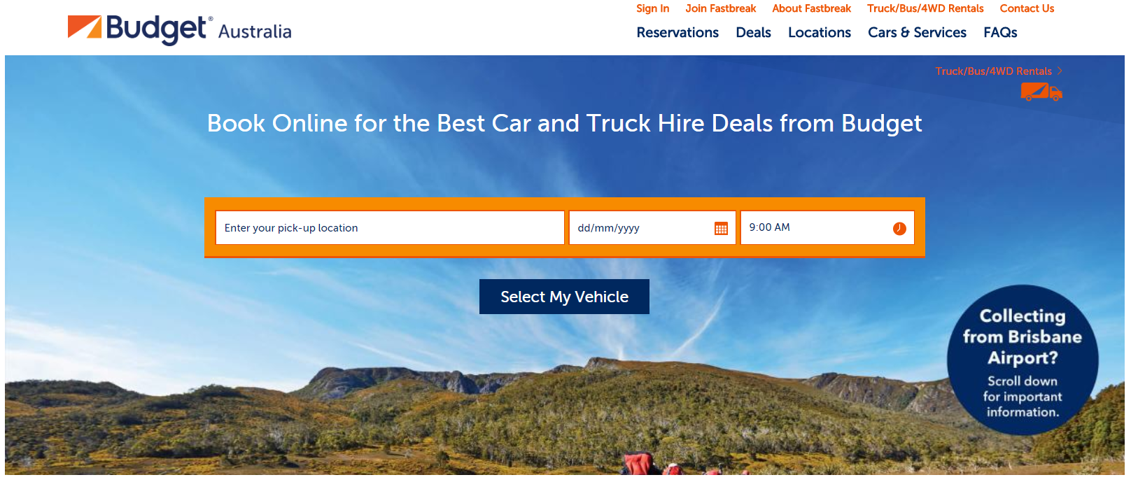
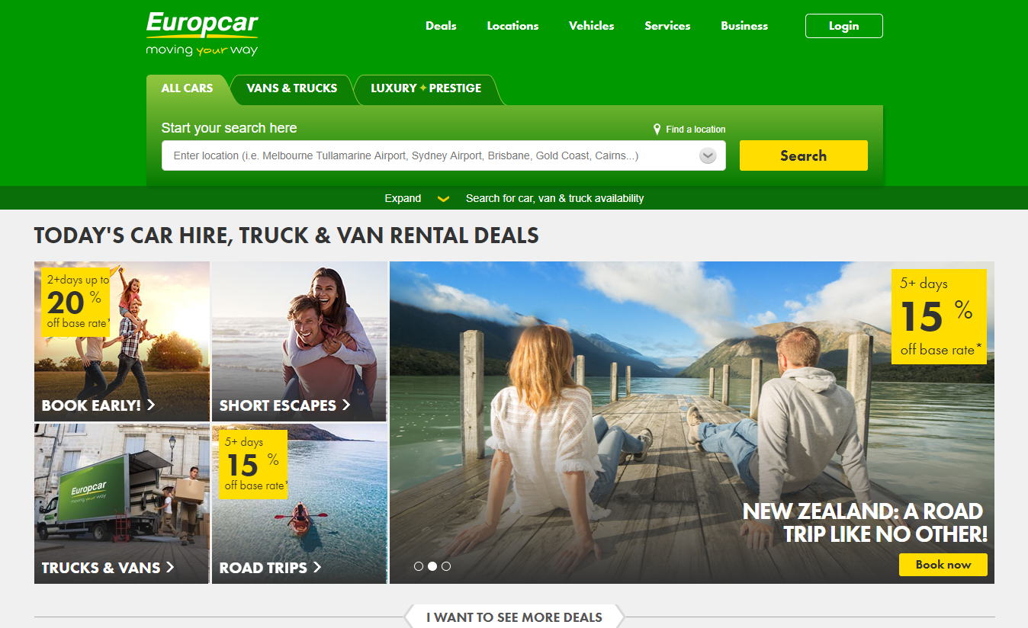
Design and Web Layout - Alana
Cohesive design throughout the site, in terms of colour and structure
Formatting is consistent with that of popular websites
Notes:
Open up to homepage, you can see search feature and as I mentioned we have kept the design simplistic and consistent with the industry
Search feature will produce a results page, where you can click on individual cars to view more information about them,
Then across to locations, users can easily view results by state or by referring to the markers on the google map
Next is our FAQ page, this can either be accessed through the header or by clicking on Need Help?
Now on the FAQ page is a link to the Contact Us page, which is also accessible through home bar
And lastly we have the sign in which you will see of in the demonstration.

Slide 4
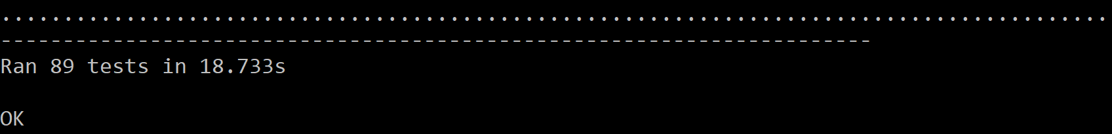
Unit Testing Results - Alana
Notes:
Within SKRAM70 -> TestApp -> Tests

Slide 5
Key User Stories Walkthrough
Customer experience:
User Stories Addressed:
Create customer account (NC01)
Customer sign in (EC01)
Updating customer information (EC02)
Search by availability (PC02)
Car recommendations (PC05)
Show car information (PC01)
View locations (PC08)

Slide 6
Key User Stories Walkthrough
Business Experience:
User Stories Addressed:
Staff Portal (B01, B07)
Access Levels (B05)
Update Car Information (SA02)
View Vehicle Returns (RI01)
View Vehicle Demographics (D01)

Slide 7
Conclusion
Any Questions?

